Slide 1
一维MeanShift
不同带宽下的聚类效果及规律

Slide 2
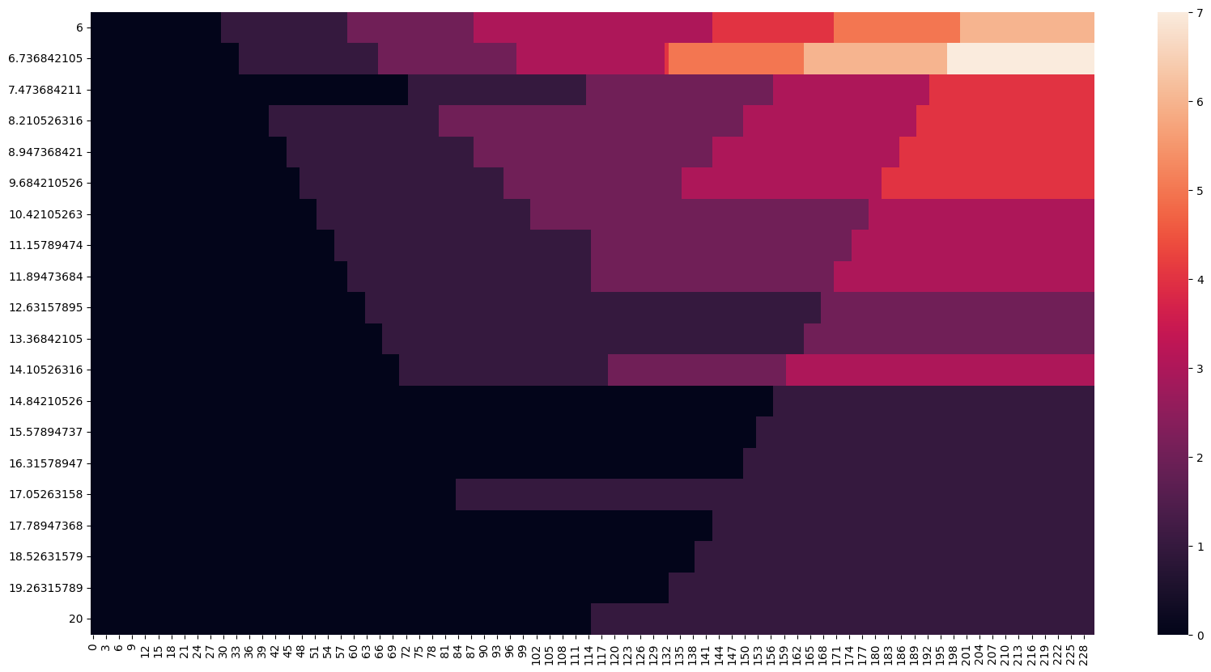
Data samples = 231; Bandwidth = 6~20;
Delta = Bandwidth / 20

Slide 3
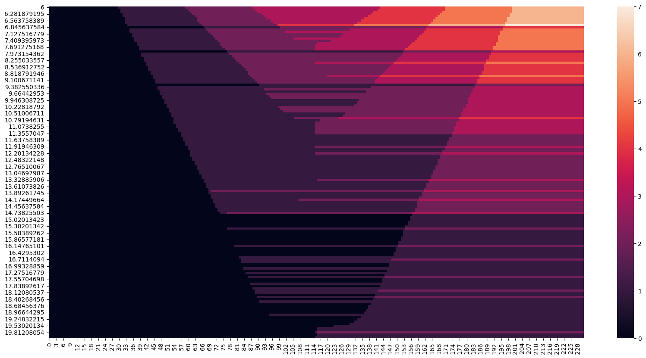
Data samples = 231; Bandwidth = 6~20;
Delta = Bandwidth / 150

Slide 4
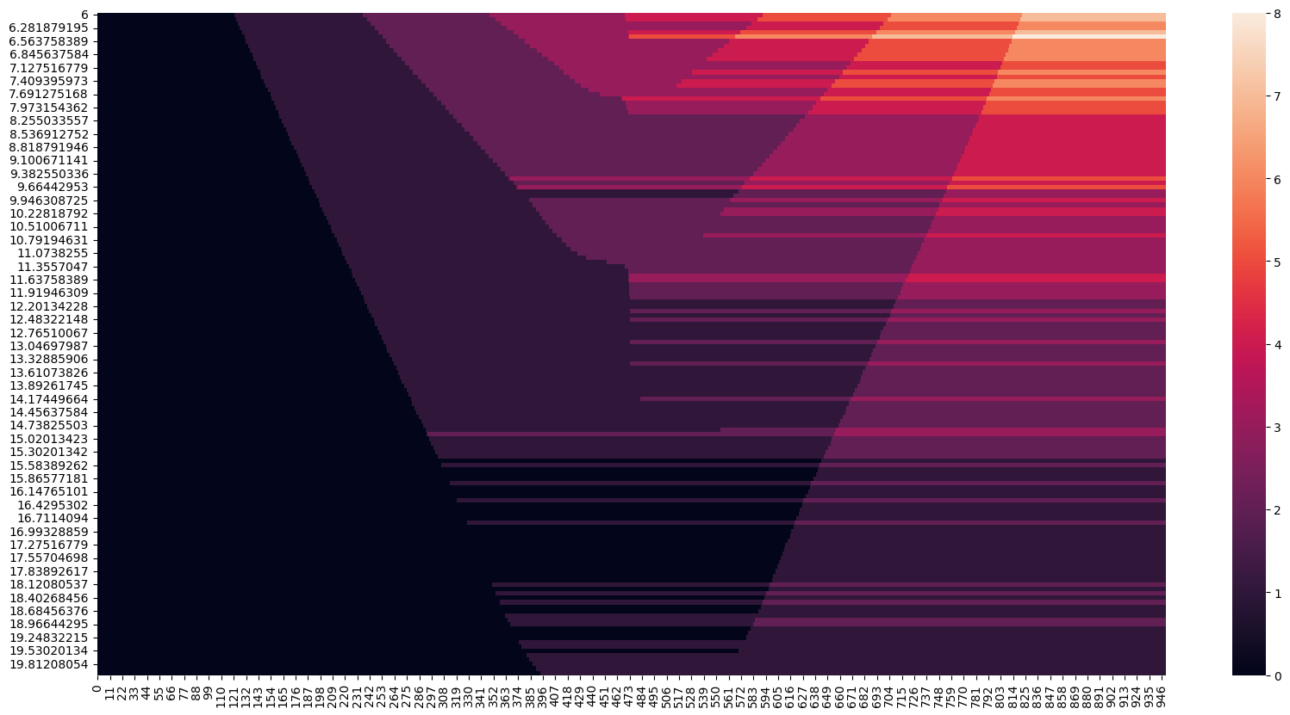
Data samples = 950; Bandwidth = 6~20;
Delta = Bandwidth / 150

Slide 5
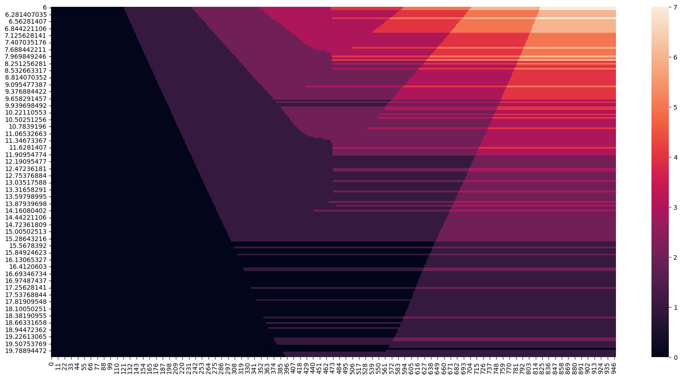
Data samples = 950; Bandwidth = 6~20;
Delta = Bandwidth / 200

Slide 6
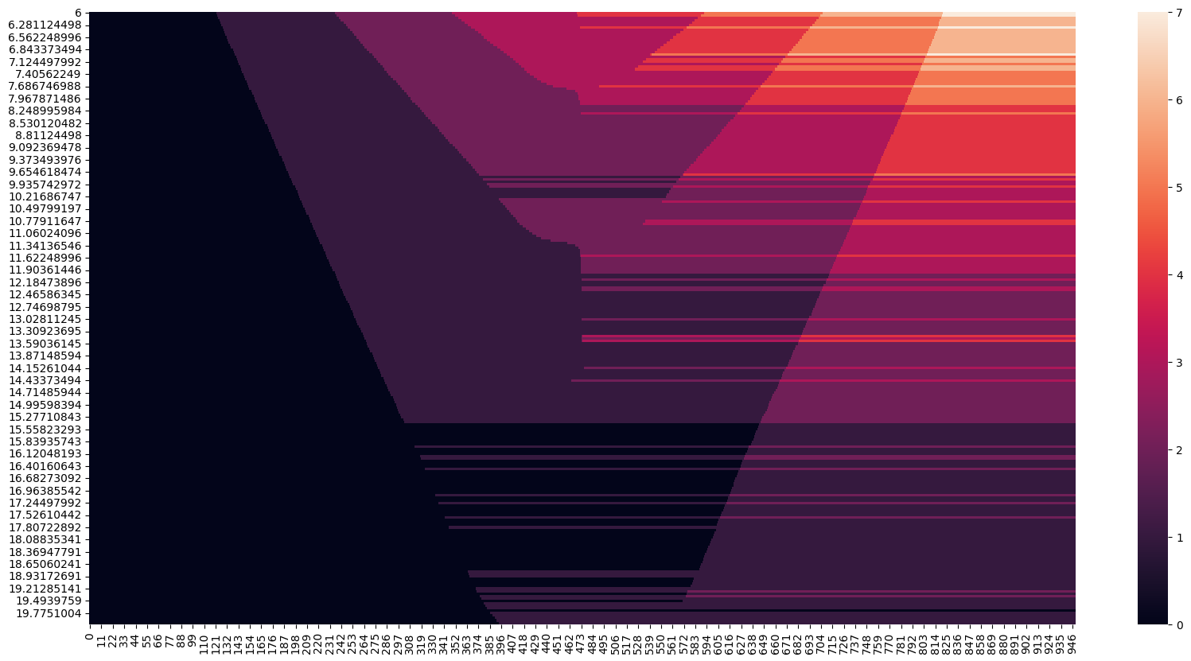
Data samples = 950; Bandwidth = 6~20;
Delta = Bandwidth / 250

Slide 7
